Slide 1

IMAGE ENCRYPTION AND DECRYPTION SCHEME USING LOGISTIC CHAOTIC MAP AND PIXEL SUBSTITUTION
CS6811-PROJECT WORK
FINAL VIVA
GUIDE: M.S. Karthika Devi, Assistant Professor(Sr.Gr.)
TEAM NUMBER: 29
TEAM MEMBERS:
Jeyasri Meenakshi[2019103530]
Niruthiya shri P[2019103549]
Ramya devi P[2019103568]

Slide 2
OVERALL OBJECTIVE
To create an efficient encryption decryption scheme which is fast and secure against various attacks.
To analyze how the proposed scheme is more efficient in terms of security and computational power than the state-of-the-art algorithms such as AES.
To ensure enhanced security of key using Secure hashing Algorithm for initial value generation.
To enhance the security of the system by using techniques such as SPN, logistic chaotic map, DCT and RSA.
To study how DCT further improves the encryption quality and how it transforms to frequency domain.
To regenerate the decrypted image as similar to the original image as possible without loss of information.

Slide 3
INTRODUCTION
Privacy is an important concern related to sharing data over the internet in our daily life.
Image security is of great importance in both military and commercial fields.
Unexpected exposure of private photos and divulged military and governmental classified images caused by malicious/ unauthorized users may lead to huge disadvantages.
The security of image information could be threatened in the process of transmission, especially in the low security channel and also in storage.
Images, however, have various intrinsic features, such as bulk data capacity and high correlation among pixels, that render traditional encryption algorithms such as DES, IDEA unsuitable.
In order to overcome the limitations of traditional encryption algorithms, we have proposed a novel image encryption and decryption scheme using logistic chaotic map and pixel substitution.
Two basic techniques to obscure high redundancies and strong correlations are confusion (substitution) and diffusion (permutation),they generally make an excellent security solution when combined.

Slide 4
LITERATURE SURVEY
TITLE | METHODOLOGY | ADVANTAGES | LIMITATION
R. Zhang and D. Xiao, A secure image permutation–substitution framework based on chaos and Compressive Sensing-2020. | A double-secrecy encryption approach based on Compressive Sensing and chaos and a novel sampling–compression–encryption framework is proposed to realise secure compressed imaging. | high level of security, as the encryption keys are derived from the chaotic maps used in the permutation step. the compressive sensing-based approach allows for the encrypted image to be stored in a compressed format, reducing the storage space required. | CS measurements cannot provide an adequate guarantee of confidentiality
A. Hamad and A. Farhan, Image encryption algorithm based on substitution principle and shuffling scheme-2020. | First phase includes an S-box based on using substitution by the AES algorithm in encryption. In the second phase, shifting and rotation were used based on a secret key depending on the result from the chaotic map, 2D logistic map. | The results showed that the algorithm is highly secure and resistant to various attacks, such as differential and statistical attacks. It is suitable for real-time image encryption applications. | AES requires high processing power and time
H. T. Panduranga, S. K. Naveen Kumar, and Kiran, Image encryption based on permutation-substitution using chaotic map and Latin square image cipher-2014. | In permutation,a plain image is permuted according to a chaotic sequence. In substitution,based on a secret key of 256 bit it generates a Latin Square Image Cipher which is used as the key image and performs XOR operation. | A big key space can provide a sufficient security against brute-force attacks. With the LSIC we encrypt the pixel values sequentially. Therefore, the diffused image is randomly distributed. | LSIC is a symmetric cipher which has a weak point in aspects of key management.

Slide 5
X.-Y. Wang, Y.-Q. Zhang, and X.-M. Bao, A colour image encryption scheme using permutation-substitution based on Chaos-2015. | An encryption scheme using a spatiotemporal chaotic system is proposed. They used the R, G and B components of a colour plain-image to form a matrix. The matrix is permuted using zigzag path scrambling. The matrix is then passed through a substitution process. | Coupled Map Lattices is used to encrypt the colour image and make the three components affect each other. The permutation and substitution stages effectively reduce the correlations between R, G and B components. | Even though it is easier to implement, the execution time is higher.
X.-Y. Wang, L. Yang, R. Liu, and A. Kadir, A chaotic image encryption algorithm based on Perceptron model-2010. | Based on the high-dimension Lorenz chaotic system and perceptron model within a neural network. | Lorenz is high dimensional so key space will be larger. System variables’ time sequence will be more erratic and unpredictable than using the low-dimension chaotic system. | Scrambling operation and the obfuscation operation processing steps are still processed in an isolated manner, and fixed control parameters are adopted in the processing. So the chaotic encryption algorithm and method still appear to be broken.

Slide 6
PROPOSED SYSTEM
To provide a much more secure yet sensitive image encryption scheme for the secure transmission of images, we have proposed a novel image encryption and decryption scheme.
Firstly, Secure Hash Algorithm(SHA) is used to generate the initial values for the logistic map.
With the knowledge of initial values, pseudo-random keystream sequences can be generated using the logistic chaotic map.
The keystream generated will then be utilised to provide the properties of confusion and diffusion by using a substitution–permutation network.
Besides, the discrete cosine transform(DCT) is used to transform the images into the frequency domain.
The values obtained through SHA will be encrypted using elliptic curve cryptography to ensure safety for transmitting the values to the receiver.
These values when decrypted by the receiver will be used for finding the keystream.
Using these keystream and applying the encryption scheme in reverse the original image could be retrieved by the receiver.

Slide 7
OVERALL ARCHITECTURE

Slide 8
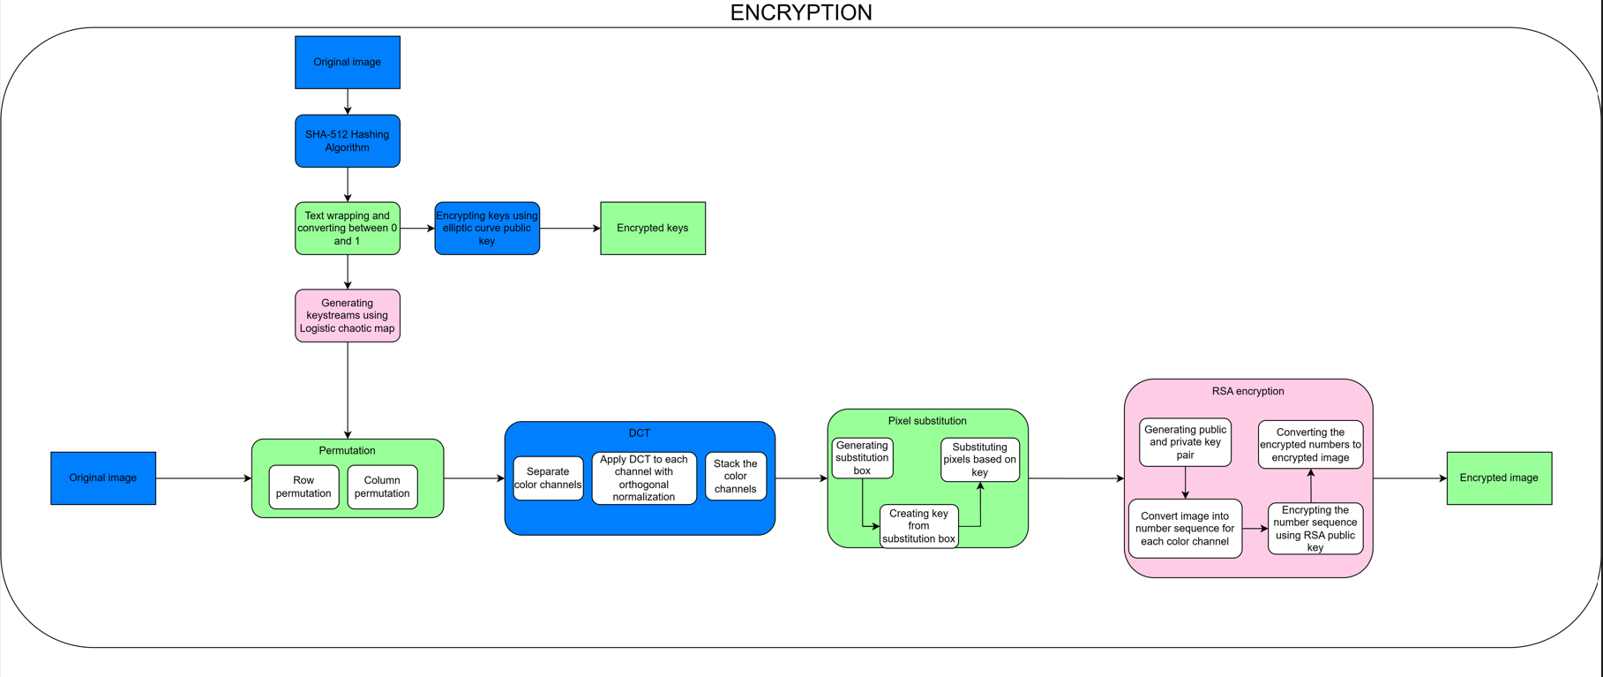
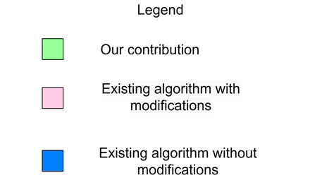
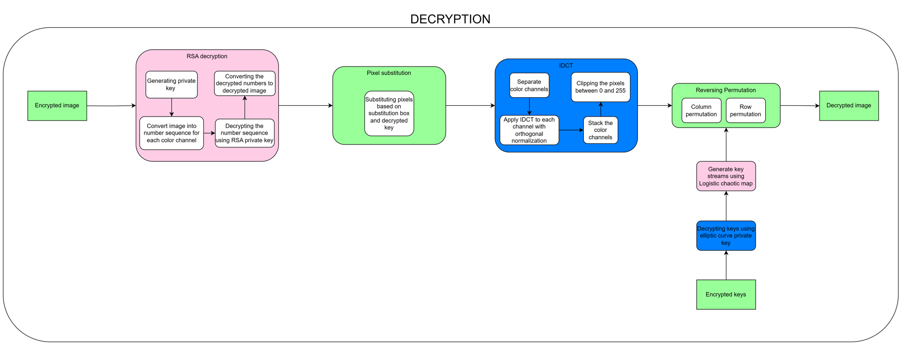

Slide 9
MODULE DESIGN
Module 1: Complete Key generation
Input: Original Image
Output : Key streams and Encrypted keys
Pseudocode:
# Generate the hash object using SHA-512 algorithm
hash_object = hashlib.sha512()
#textwrap
prekeys=textwrap.wrap(hash_hex, 32)
# Generate a private key using P-256 curve
private_key = ec.generate_private_key(ec.SECP256R1())
# Get the corresponding public key
public_key = private_key.public_key()
# Convert the public key to bytes and hash it
key_hash = hashlib.sha256(public_key_bytes).digest()

Slide 10
#encrypt key using keyhash
for i from 1 to N do
x = r * x0 * (1 - x0) // Compute the next value of "x" using the logistic map equation
x0 = x // Set the current value of "x" to the previous value for the next iteration
end for

Slide 11
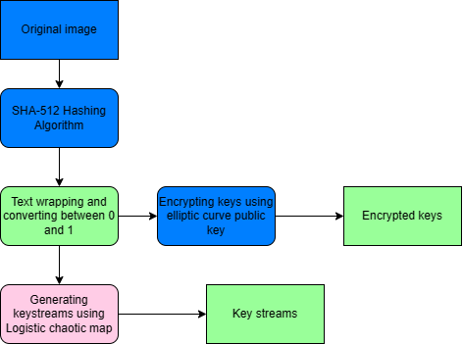

Slide 12
Module 2 : Permutation
Row Permutation
Input : Original image
Output : Row permuted encrypted image
Pseudocode for row permutation:
// Define the image dimensions
image_width = ...
image_height = …
// Define the permutation order for the rows based on keystream1
permutation_order = ...
// Initialize a new image with the same dimensions as the original
new_image = create_image(image_width, image_height)

Slide 13
// Loop through each row in the original image, using the permutation order
for i = 0 to image_height - 1:
// Get the index of the row to copy from the original image
row_index = permutation_order[i]
// Loop through each pixel in the row
for j = 0 to image_width - 1:
// Copy the pixel from the original image to the corresponding position in the new image
new_image[j, i] = original_image[j, row_index]
// The new image now contains the original image with its rows permuted

Slide 14
Column Permutation
Input: Row permuted encrypted image
Output : Level 1 encrypted image
Pseudocode for column permutation:
// Define the image dimensions
image_width = ...
image_height = ...
// Define the permutation order for the columns
permutation_order = …
// Initialize a new image with the same dimensions as the original
new_image = create_image(image_width, image_height)

Slide 15
// Loop through each column in the original image, using the permutation order
for j = 0 to image_width - 1:
// Get the index of the column to copy from the original image
column_index = permutation_order[j]
// Loop through each pixel in the column
for i = 0 to image_height - 1:
// Copy the pixel from the original image to the corresponding position in the new image
new_image[j, i] = original_image[column_index, i]
// The new image now contains the original image with its columns permuted

Slide 16
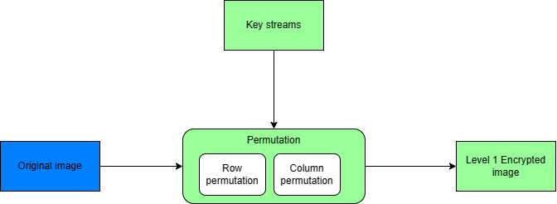

Slide 17
Module 3: DCT
Input : Level 1 encrypted image
Output: Level 2 Encrypted Image
Pseudocode:
// Initialize parameters
block_size = 8 // Set the block size
image = read_image() // Read the image from a file
// Compute DCT for each block of pixels
for each block of size block_size x block_size in the image do

Slide 18
// Compute the DCT for each coefficient in the block
for u from 0 to block_size - 1 do
for v from 0 to block_size - 1 do
// Compute the sum for the current coefficient
sum = 0
for x from 0 to block_size - 1 do
for y from 0 to block_size - 1 do
coefficient = image[x + block_x][y + block_y] // Get the pixel value for the current (x, y) position
Cu = Cv = 1/sqrt(2) // Set the constant factors to 1/sqrt(2) for u = v = 0, and 1 otherwise
if u == 0 then Cu = 1/sqrt(2)
if v == 0 then Cv = 1/sqrt(2)
sum += Cu * Cv * coefficient * cos((2*x+1)*u*pi/(2*block_size)) * cos((2*y+1)*v*pi/(2*block_size))
end for

Slide 19
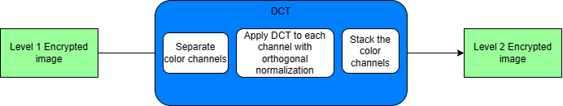
// Normalize and store the current DCT coefficient
DCT_coefficients[u][v] = sum * (2/block_size) * (2/block_size)
end for
end for
// Store the DCT coefficients for the current block in a file
write_DCT_coefficients(DCT_coefficients)
end for

Slide 20
Module 4: Pixel Substitution
Input : Level 2 Encrypted Image
Output : Level 3 Encrypted Image
Pseudocode:
// Initialize parameters
image = read_image() // Read the image from a file
key = generate_key() // Generate a random key
substitution_box = generate_substitution_box() // Generate a random substitution box
num_pixels = get_num_pixels(image) // Get the number of pixels in the image

Slide 21
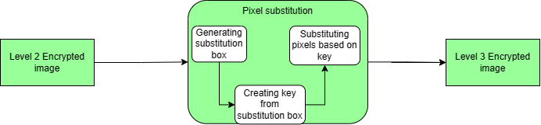
// Encrypt image by substitution using key and substitution box
for i from 0 to num_pixels - 1 do
pixel = image[i] // Get the current pixel
new_pixel = substitute_pixel(pixel, substitution_box) // Substitute the pixel using the substitution box
encrypted_pixel = encrypt_pixel(new_pixel, key) // Encrypt the substituted pixel using the key
image[i] = encrypted_pixel // Store the encrypted pixel in the image
end for
// Save encrypted image to file
save_image(image, "encrypted_image.png")
save_substitution_box(substitution_box, "substitution_box.txt")

Slide 22
Module 5: RSA Encryption
Input : Level 3 Encrypted Image
Output : Final Encrypted image
Pseudocode for RSA encryption of a coloured image:
// Initialize the RSA keys
public_key, private_key = generate_RSA_keys()
// Load the image
image = load_image('image.png')
// Split the image into its color channels (e.g. Red, Green, Blue)
red_channel, green_channel, blue_channel = split_image_into_channels(image)

Slide 23
// Loop through each color channel
for channel in [red_channel, green_channel, blue_channel]:
// Flatten the color channel to a 1D array of pixel values
pixel_values = flatten_channel_to_array(channel)
// Encrypt the pixel values using RSA
encrypted_values = []
for pixel_value in pixel_values:
encrypted_value = RSA_encrypt(pixel_value, public_key)
encrypted_values.append(encrypted_value)
// Replace the original pixel values with the encrypted ones in the color channel
replace_channel_with_encrypted_values(channel, encrypted_values)
// Merge the color channels back into a single image
encrypted_image = merge_channels_into_image(red_channel, green_channel, blue_channel)
// Save the encrypted image
save_image(encrypted_image, 'encrypted_image.png')

Slide 24
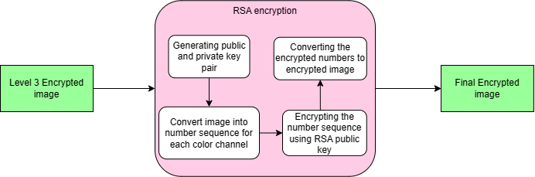

Slide 25
Module 6: RSA Decryption
Input :Final encrypted image
Output : Level 1 Decrypted image
Pseudocode for RSA decryption of a coloured image:
// Initialize the RSA keys
public_key, private_key = generate_RSA_keys()
// Load the image
image = load_image('image.png')
// Split the image into its color channels (e.g. Red, Green, Blue)
red_channel, green_channel, blue_channel = split_image_into_channels(image)

Slide 26
// Loop through each color channel
for channel in [red_channel, green_channel, blue_channel]:
// Flatten the color channel to a 1D array of pixel values
pixel_values = flatten_channel_to_array(channel)
// Decrypt the pixel values using RSA
decrypted_values = []
for pixel_value in pixel_values:
decrypted_value = RSA_decrypt(pixel_value, private_key)
decrypted_values.append(decrypted_value)
// Replace the original pixel values with the encrypted ones in the color channel
replace_channel_with_decrypted_values(channel, decrypted_values)
// Merge the color channels back into a single image
decrypted_image = merge_channels_into_image(red_channel, green_channel, blue_channel)
save_image(decrypted_image, 'decrypted_image.png')

Slide 27
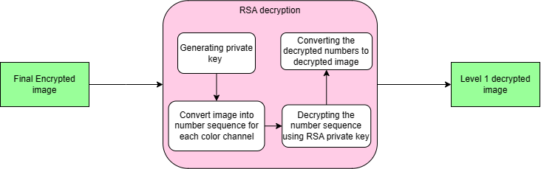

Slide 28
Module 7: Reversing Pixel Substitution
Input : Level 1 decrypted Image
Output : Level 2 decrypted Image
Pseudocode:
// Initialize parameters
image = read_image() // Read the image from a file
num_pixels = get_num_pixels(image) // Get the number of pixels in the image
// Decrypt image by substitution using key and substitution box
for i from 0 to num_pixels - 1 do
pixel = image[i] // Get the current pixel

Slide 29
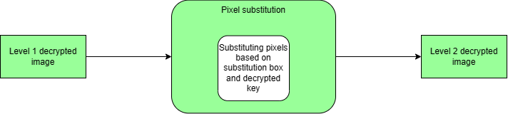
decrypted_pixel = decrypt_pixel(pixel, key) // Decrypt the substituted pixel using the key
new_pixel = substitute_pixel(decypted_pixel, substitution_box) // Substitute the pixel using the substitution box
image[i] = new_pixel // Store the decrypted pixel in the image
end for
// Save decrypted image to file
save_image(image, "decrypted_image.png")

Slide 30
Module 8: IDCT
Input : Level 2 decrypted image
Output: Level 3 decrypted Image
Pseudocode:
// Initialize parameters
block_size = 8 // Set the block size
DCT_coefficients = read_DCT_coefficients() // Read the DCT coefficients from a file
// Perform IDCT on each block of coefficients
for each block of DCT_coefficients do

Slide 31
// Compute the IDCT for each pixel in the block
for x from 0 to block_size - 1 do
for y from 0 to block_size - 1 do
// Compute the sum of DCT coefficients for the current pixel
sum = 0
for u from 0 to block_size - 1 do
for v from 0 to block_size - 1 do
Cu = Cv = 1/sqrt(2) // Set the constant factors to 1/sqrt(2) for u = v = 0, and 1 otherwise
if u == 0 then Cu = 1/sqrt(2)
if v == 0 then Cv = 1/sqrt(2)
sum += Cu * Cv * DCT_coefficients[u][v] * cos((2*x+1)*u*pi/(2*block_size)) * cos((2*y+1)*v*pi/(2*block_size))
end for
// Scale and round the sum to obtain the reconstructed pixel value
pixel_value = round(sum * (2/block_size) + 128)

Slide 32
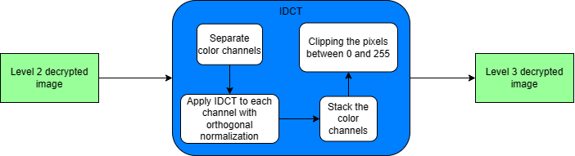
// Clamp the pixel value to [0, 255]
if pixel_value < 0 then pixel_value = 0
if pixel_value > 255 then pixel_value = 255
// Store the reconstructed pixel value
reconstructed_block[x][y] = pixel_value
end for
end for
// Store the reconstructed block in the image
write_reconstructed_block(reconstructed_block)
end for

Slide 33
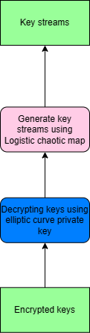
Module 9 : Generating Key Streams
Input : Encrypted keys
Output : Key streams
Pseudocode for logistic chaotic map:
Initialize r and x0
for i from 1 to N do
x = r * x0 * (1 - x0) // Compute the next value of "x" using the logistic map equation
x0 = x // Set the current value of "x" to the previous value for the next iteration
end for

Slide 34
Module 10 :Reversing Permutation
Reversing Column Permutation
Input: Level 3 decrypted image
Output : Column permuted decrypted image
Pseudocode for column permutation:
// Define the image dimensions
image_width = ...
image_height = …
// Initialize a new image with the same dimensions as the original
new_image = create_image(image_width, image_height)

Slide 35
// Loop through each column in the original image, using the permutation order
for j = 0 to image_width - 1:
// Get the index of the column to copy from the original image
column_index = permutation_order[j]
// Loop through each pixel in the column
for i = 0 to image_height - 1:
// Copy the pixel from the original image to the corresponding position in the new image
new_image[j, i] = original_image[column_index, i]
// The new image now contains the original image with its columns permuted

Slide 36
Reversing Row Permutation
Input:Column permuted decrypted image
Output : Final decrypted image
Pseudocode for row permutation:
// Define the image dimensions
image_width = ...
image_height = ...
// Define the permutation order for the rows
permutation_order = …
// Initialize a new image with the same dimensions as the original
new_image = create_image(image_width, image_height)

Slide 37
// Loop through each row in the original image, using the permutation order
for i = 0 to image_height - 1:
// Get the index of the row to copy from the original image
row_index = permutation_order[i]
// Loop through each pixel in the row
for j = 0 to image_width - 1:
// Copy the pixel from the original image to the corresponding position in the new image
new_image[j, i] = original_image[j, row_index]
// The new image now contains the original image with its rows permuted

Slide 38
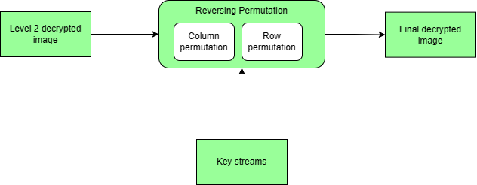

Slide 39
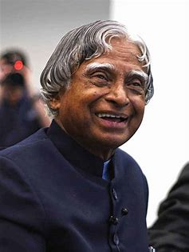
RESULTS
Original Image

Slide 40
1)SHA-512 Hashing Algorithm
A hash value using SHA 512 algorithm from the original image is computed.
Result:
SHA-512 hash value: 4f21112fde7d353f46c2c3d9060017b872a812c69f20326098932e36e1417c52247e1147c9de5d059e396cf4f006e107b24ae65da880b0c90b23f1113aafe73e
The hashed value is text wrapped and 4 parts of key are generated which is then converted between 0 and 1
Result:
Text wrapped hash: ['4f21112fde7d353f46c2c3d9060017b8','72a812c69f20326098932e36e1417c52','247e1147c9de5d059e396cf4f006e107','B24ae65da880b0c90b23f1113aafe73e']
Hash value converted between 0 and 1:
[0.6813634732871632, 0.645434551970951, 0.9163225706236457, 0.3173707059910187]
2)Text Wrapping and converting between 0 and 1

Slide 41
3)Encrypting keys using Elliptic curve cryptography
The keys are encrypted using elliptic curve cryptography’s public key which will be sent to receiver.
Result:
Original value: 0.6813634732871632
Encrypted value: b'&7\xf3\xc3b\xd1\xad\x89\xe427\x80u]\x989\xb6\x9d'
Original value: 0.645434551970951
Encrypted value: b'&7\xf3\xcff\xd6\xa8\x8e\xe505\x8bzZ\x90:\xb4'
Original value: 0.9163225706236457
Encrypted value: b'&7\xfc\xcae\xd1\xa9\x88\xe524\x84\x7fY\x9f;\xb0\x98'
Original value: 0.3173707059910187
Encrypted value: b'&7\xf6\xcad\xd1\xac\x8a\xe751\x8bt[\x99>\xbd\x98'

Slide 42

4)Generating Keystreams using Logistic Chaotic Map
Using logistic chaotic map keystreams are generated from non encrypted values.
Result:[1385, 739, 1586, 51, 199, 697, 1569, 116, 430, 1256]
5)Row Permutation using generated keystream
Result:
The image is converted into a numpy array.
A permutation index array is generated using the keystream.
The float array key is used to seed the random number generator ,a permutation index array is generated.
Then the rows of the image array are permuted using the permutation index array.
The permuted image array is converted back to an image

Slide 43

6)Column Permutation using generated keystream
The image is converted into a numpy array.
The permutation index array based on the key array is generated.
An index array is created which sorts the key in ascending order.
This index array is applied to the columns of the image array using numpy's indexing.
The permuted image array is converted back to an image
Result:

Slide 44
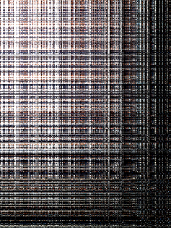
7)DCT
The input to this module will be a column permuted image.
The colour channels of the image namely B,G,R are separated.
Then DCT is applied to each colour channel performing a block-wise DCT using orthogonal normalisation.
Then the colour channels are stacked to get the DCT encrypted image.
Result:

Slide 45
8)Generating substitution box and key
A substitution box based on the parameters of the image is generated.
Then a random key is generated as the same size of the substitution box.
Result:
Substitution box: [[[215 12 222] [186 92 36] [188 32 183] ... [102 252 188] [ 10 138 237] [126 106 102]] [[ 45 5 208] [ 55 204 109] [115 3 131] ... [129 228 80] [ 29 81 110] [ 72 160 93]] [[232 163 121] [ 69 134 20] [ 75 241 0] ... [ 9 171 93] [110 216 65] [ 44 165 193]] …​
​
Key: [[[ 82 179 58] [ 1 254 210] [ 5 27 46] ... [184 82 198] [ 6 214 14] [101 49 253]] [[100 14 143] [182 159 155] [124 63 107] ... [128 3 221] [228 156 161] [ 43 121 82]] [[ 95 94 90] [153 1 110] [124 165 230] ... [ 14 111 144] [237 154 61] [ 40 63 139]] ...

Slide 46

9)Substituting pixels using key
The pixels are substituted based on keys generating an image and it has its pixels substituted based on the key.
Result:

Slide 47

10)RSA Encryption
Using RSA a pair of public and private key is generated.
The pixel substituted Image is then converted into sequence of numbers.
Then the number sequence is encrypted with the public key.
This encrypted number sequence is converted back to image.
This is the final encrypted image of the whole proposed scheme
Result:

Slide 48
11)RSA Decryption
The final encrypted image is converted into a sequence of numbers.
Then the number sequence is decrypted using the private key.
The decrypted number sequence is converted back to image
Result:

Slide 49
12)Reversing substitution
The decrypted image from RSA is taken as input producing an output of a re-substituted image.
The key for substitution is decrypted.
Using the substitution box and the decrypted key the pixels are substituted to get the pixel substituted image.
Result:

Slide 50

13)IDCT
The colour channels are separated.
Then for each channel IDCT performs a block-wise IDCT using orthogonal Normalisation.
The colour channels are stacked and pixels are clipped between 0 and 255 to get the decrypted image
Result:

Slide 51
14)Decrypting key using elliptic key cryptography
The key streams which is to be used for decryption are produced using the private key and the encrypted key values passed to the sender.
The encrypted keys will be decrypted using Elliptic curve cryptography
Result:
[0.6813634732871632, 0.645434551970951, 0.9163225706236457, 0.3173707059910187]

Slide 52
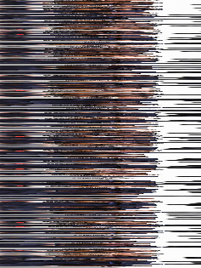
15)Generating Keystreams using Logistic Chaotic Map
The key streams using ECC's decrypted keys are generated using logistic chaotic map.
Result:
[1385, 739, 1586, 51, 199, 697, 1569, 116, 430, 1256]
16)Reversing column permutation
Result:
The key stream 2 is used for reverse permuting the IDCT image producing a column permuted image
An array is obtained from the input image which is permuted column wise
using the keystream.​
The permuted array will be converted back to image.

Slide 53

17)Reversing row permutation
The column permuted image is taken as the input.
An array is constructed from the image.
The image array is row permuted using key stream 1.
The permuted array is converted back to the image.
Result:

Slide 54
PERFORMANCE METRICS
1.Intensity Histogram
It provides us with a graphical representation of the intensity distribution of an image.
A good image encryption algorithm should make the pixels of the encrypted image more evenly distributed to effectively resist against statistical attacks.
If the encrypted image has uniform histogram, it hides information about the original image effectively and if not,it is enough would capture information about the original image.

Slide 55
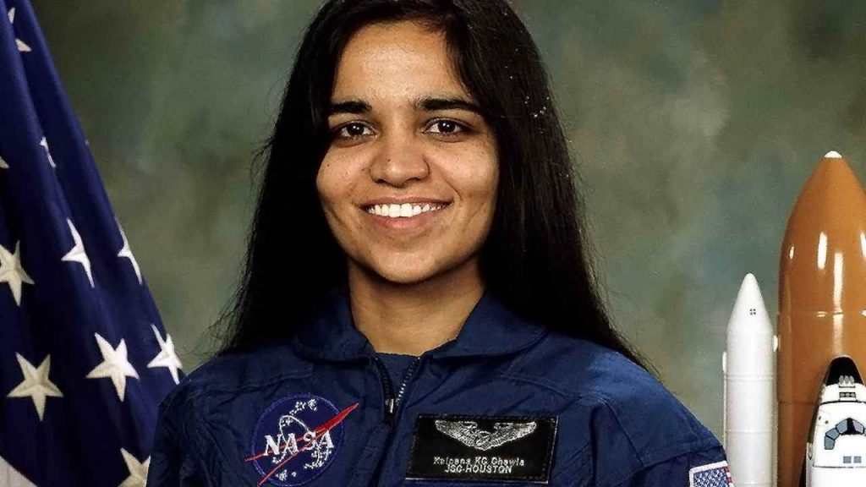
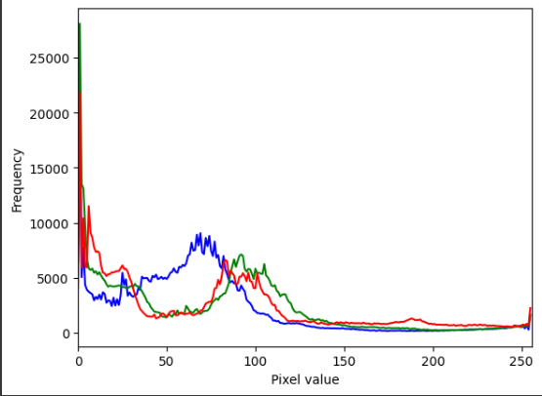

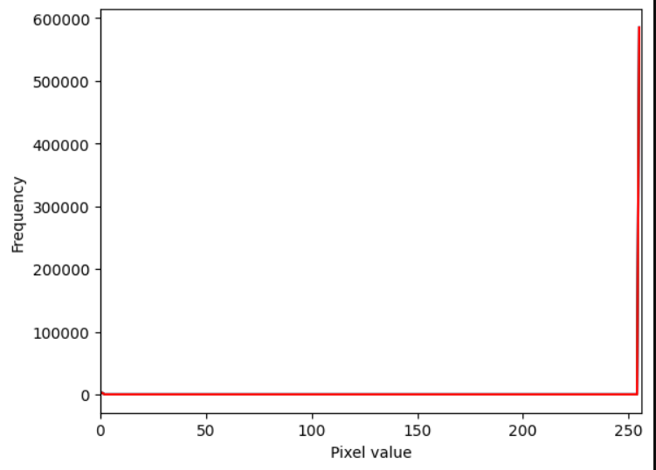
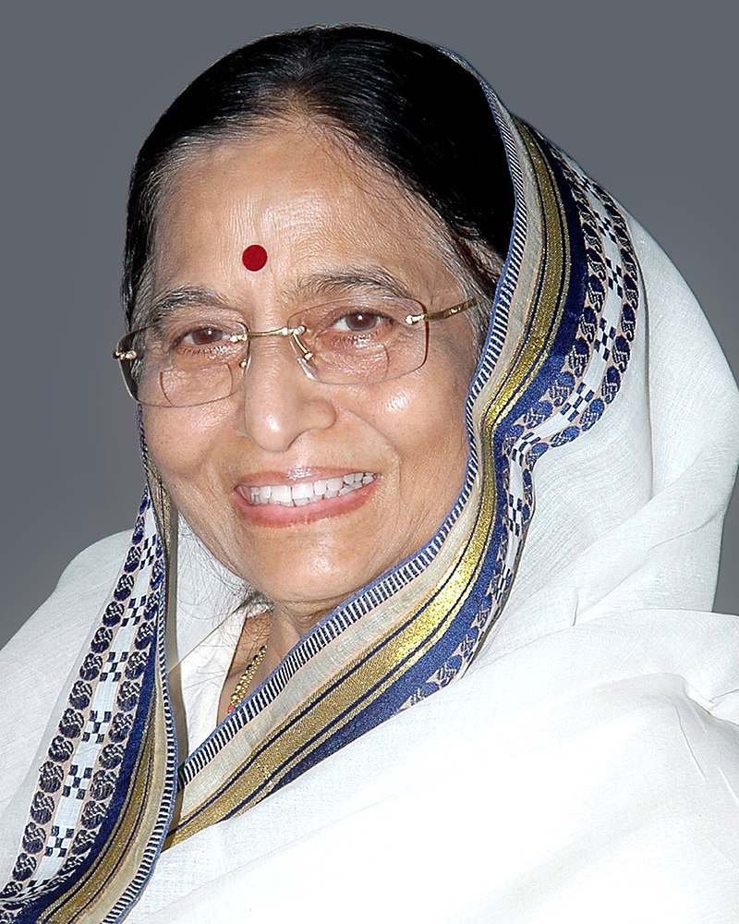
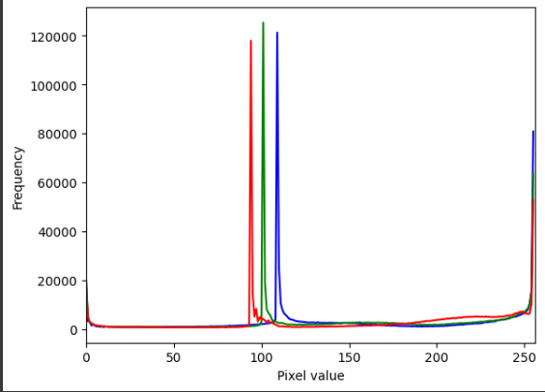

Original image | Histogram of original image | Encrypted image | Histogram of encrypted image

Slide 56
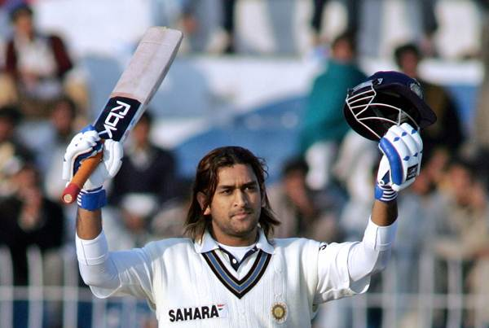
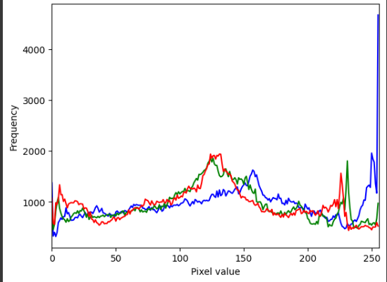
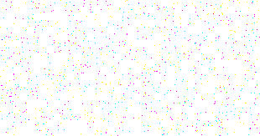

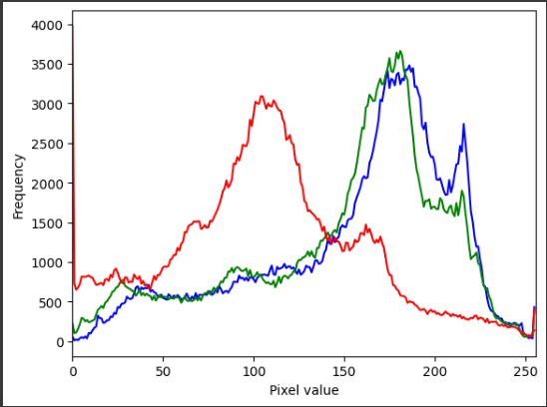

Original image | Histogram of original image | Encrypted image | Histogram of encrypted image

Slide 57
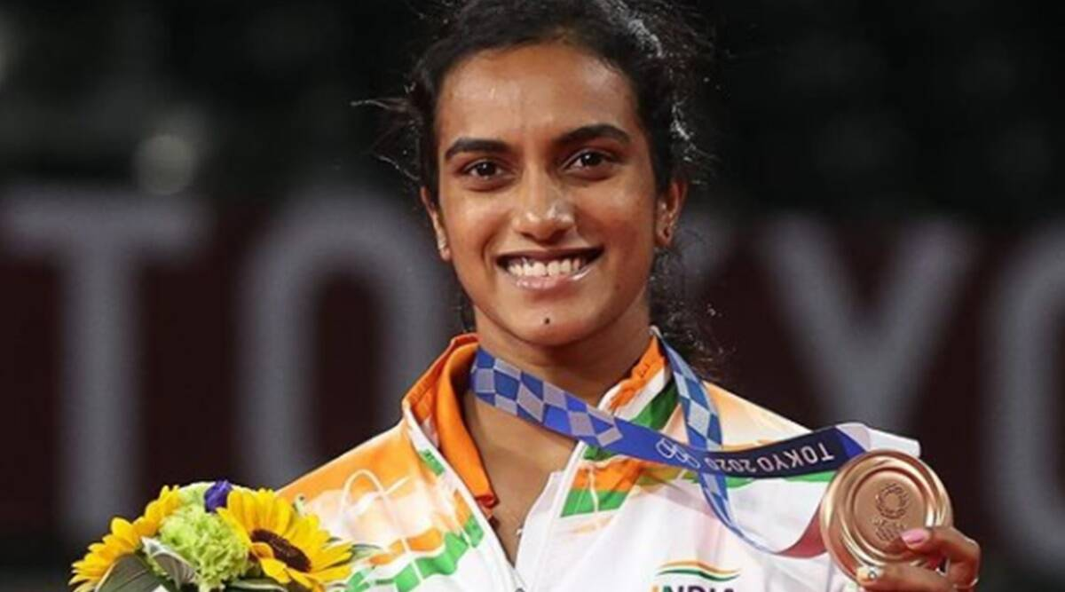
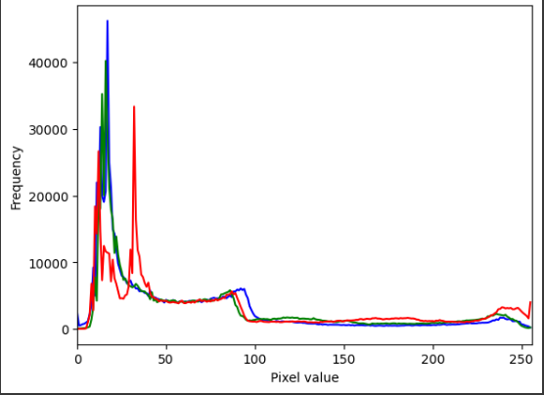
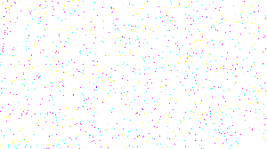
Original image | Histogram of original image | Encrypted image | Histogram of encrypted image

Slide 58
2.Correlation coefficient
CC is used to measure the association between two variables.
In images, the pixels are highly correlated, and thus, image encryption algorithms mainly focus on reducing the association between the pixels of an encrypted image.
The correlation coefficient is scaled between +1 and −1, where +1 indicates a maximum positive correlation, and −1 indicates a maximum negative correlation between two variables.

Slide 59
Correlation coefficient b/w original and encrypted image:
Image | CC
Kalpana chawla | -0.00031
Pratibha Patel | 0.00014
M S Dhoni | -0.00024
A R Rahman | 0.00128
P V Sindhu | 0.00019
AVG | 0.00021

Slide 60
3.Key sensitivity analysis
A good image encryption scheme should be highly sensitive to the changes of key.
So a minor change in the encryption key or the plain text would result in a completely different encrypted image.
There will be great differences in the encrypted images with the changes of the initial value.
Only the correct key can recover the original image.
The correct decrypted key from elliptic curve cryptography with its decrypted image and the key with a slight variation in its decimal point with its decrypted image is shown in Figure.

Slide 61

Key | Original image | Decrypted image
[0.6620373659022047, 0.564744967678191, 0.5833264301928258, 0.4719525592490519]
[0.6720373659022048, 0.564744967678191, 0.5833264301928258, 0.4719525592490519]

Slide 62
4.Horizontal,Vertical and Diagonal Correlation coefficient of adjacent pixels
A good encryption scheme should have minimal level of correlation between adjacent pixels.
In horizontal correlation the adjacent rows are compared for correlation.
The columns are compared in case of vertical correlation and diagonal correlation is analysed for diagonals.
If the correlation value is 1 it means it is highly correlated and any value less than 0 shows minimum correlation between the adjacent pixels.
The proposed scheme has a smaller vertical correlation coefficient, horizontal correlation coefficient, and diagonal correlation coefficient and is more resistant to attacks.

Slide 63
Image | HCC | VCC | DCC
Kalpana chawla | 0.02708 | 0.02708 | 0.08124
Pratibha Patel | -0.00628 | -0.00627 | -0.01886
M S Dhoni | -0.00978 | -0.00977 | -0.02936
A R Rahman | -0.00664 | -0.00663 | -0.01993
P V Sindhu | -0.00905 | -0.00904 | -0.02716
AVG: | -0.00093 | -0.00092 | -0.00281

Slide 64
5.Encryption time
The machine used to test the performance of the proposed algorithm has an Intel Core i5 CPU running at 3.5 GHz.
The machine has 12 GB of RAM and runs the Windows 10 operating system.
The proposed algorithm is run in Google colab.The results indicate that the proposed algorithm has the fastest encryption speed.
Image | Size | Encryption time(s)
Kalpana chawla | 1024 × 576 | 0.12
Pratibha Patel | 800 × 1000 | 0.16
M S Dhoni | 600 × 403 | 0.09
A R Rahman | 720 × 405 | 0.10
P V Sindhu | 1200 × 667 | 0.15
AVG: |  | 0.12

Slide 65
6.Normalised correlation(NC)
This is measured for level of similarity between pixels of two images.
Here the correlation value between the original image given as input and output image i.e the final decrypted image is obtained.
NC = 0.9999145887809855
The ideal value tends to be 1 which shows the two images i.e original image and decrypted images are completely same.

Slide 66
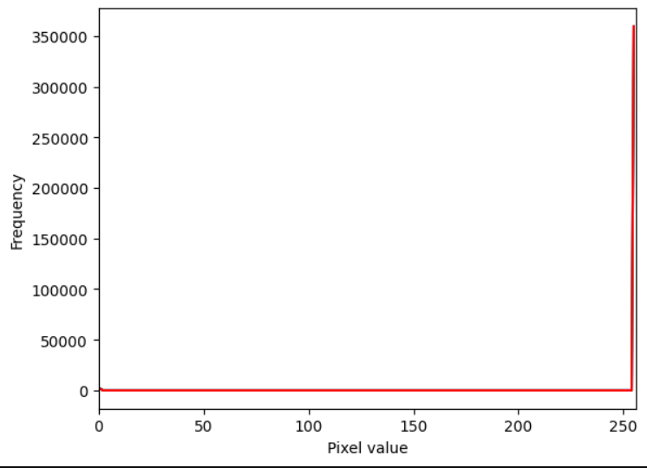
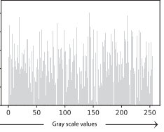
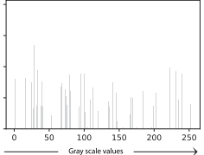
COMPARATIVE ANALYSIS
1.Intensity histogram
The histogram of the encrypted images needs to be uniformly distributed.
The histogram for the proposed scheme is more uniform than the histogram of the encrypted image using the Anees et al. [4] method, (i.e) encrypted images using the proposed scheme hides more information and are more resistant against attacks.
Image | Proposed scheme histogram | Anees et al.[4] histogram
Baboon
Lena

Slide 67
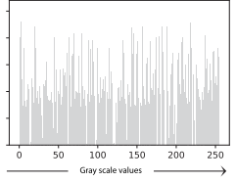
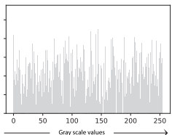
Image | Proposed scheme histogram | Anees et al.[4] histogram
Zelda
Pepper

Slide 68
2.Correlation Coefficient
In correlation coefficient between the original image and the encrypted image in our proposed system is shown.
This CC is lower when compared to the avg CC obtained in Abdallah et al.[1] which is shown in Table .
The CC of our proposed scheme being lower indicates that pixels of original images are highly changed through various steps of encryption scheme to make them less correlated.
This makes it difficult to decrypt the image to get the original image thus protecting the images from being prone to attacks.
Correlation coefficient
Images | Proposed scheme | Abdallah et al.[1]
Barbara | 0.0001 | 0.0011
Baboon | -0.0006 | 0.0001
Lena | 0.0019 | 0.0023

Slide 69
3.Horizontal,Vertical and Diagonal Correlation coefficient of adjacent pixels
The Horizontal Correlation Coefficient[HCC],Vertical Correlation Coefficient[VCC],Diagonal Correlation Coefficient[DCC] represents the correlation between adjacent pixels of the encrypted images and it should be as minimal as possible.
The average value of our scheme and some of the methods in the works of our references are shown.
The HCC,VCC,DCC of our proposed scheme when compared to others works shows that ours has a lower value.
This indicates that the adjacent pixels are highly uncorrelated in the encrypted images making it much more secure when compared to other works.
.

Slide 70
.
Literature | HCC | VCC | DCC
Alghamdi et al.[3] | 0.0004 | 0.0005 | −0.0004
Arif et al.[5] | 0.00081 | 0.00061 | 0.03447
Hua et al.[9] | 0.0023 | -0.0086 | 0.0402
Lu et al.[11] | 0.0007 | −0.0004 | 0.0029
Alanezi et al.[2] | −0.0002 | −0.0001 | 0.0011
Samiullah et al.[16] | -0.0357 | -0.0357 | -0.0223
Ge et al.[7] | -0.0004 | 0.00027 | -0.00035
Proposed scheme | -0.00093 | -0.00092 | -0.00281

Slide 71
4.Encryption time
The encryption time of various test images and other references have been found and their average is shown in Table.
Our scheme has more layers for encryption when compared to other works mentioned in references. Yet our scheme has a better speed of encryption.
The proposed scheme puts forth a much secure at the same time faster encryption method for encrypting larger number images in a shorter time with much better level of security than other methods compared thereforth.
.
Literature | Encryption time(s)
Alghamdi et al.[3] | 0.09
Arif et al.[5] | 1.28
Hua et al.[9] | 0.23
Lu et al.[11] | 1.24
Alanezi et al.[2] | 0.30
Samiullah et al.[16] | 22.43
Ge et al.[7] | 0.027
Proposed scheme | 0.12

Slide 72

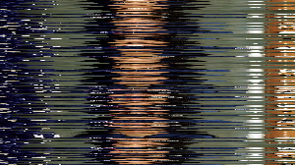
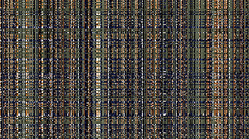
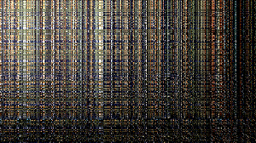

TEST CASES
1.Kalpana chawla image:
Input:
Dimension: 1024 * 576
Row permuted image | Column permuted image | DCT output image | Pixel substituted image | RSA encrypted image(Final encrypted image)

Slide 73
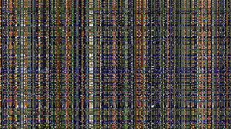

RSA decrypted image | Reverse pixel substituted image | IDCT output image | Reverse column permuted image | Reverse row permuted image(Obtained output) | Target output

Slide 74
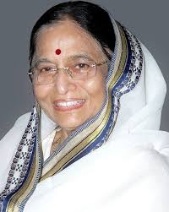
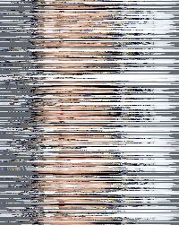
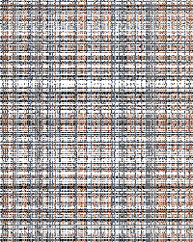
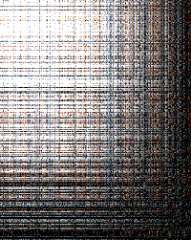

2.Pratibha patel image:
Input:
Dimension: 800 * 1000
Row permuted image | Column permuted image | DCT output image | Pixel substituted image | RSA encrypted image(Final encrypted image)

Slide 75
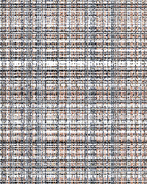

RSA decrypted image | Reverse pixel substituted image | IDCT output image | Reverse column permuted image | Reverse row permuted image(Obtained output) | Target output

Slide 76
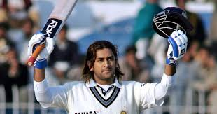

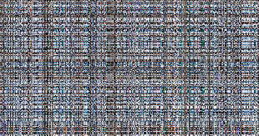
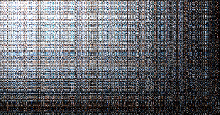

3.M.S.Dhoni image:
Input:
Dimension: 600 * 403
Row permuted image | Column permuted image | DCT output image | Pixel substituted image | RSA encrypted image(Final encrypted image)

Slide 77
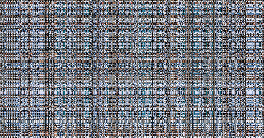


RSA decrypted image | Reverse pixel substituted image | IDCT output image | Reverse column permuted image | Reverse row permuted image(Obtained output) | Target output

Slide 78

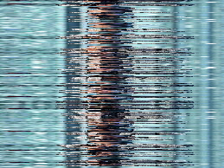
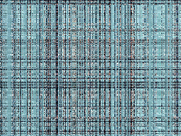
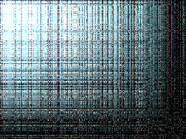

4.A.R.Rahman image:
Input:
Dimension: 720 * 405
Row permuted image | Column permuted image | DCT output image | Pixel substituted image | RSA encrypted image(Final encrypted image)

Slide 79
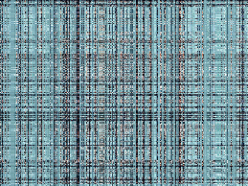

RSA decrypted image | Reverse pixel substituted image | IDCT output image | Reverse column permuted image | Reverse row permuted image(Obtained output) | Target output

Slide 80





5.P.V.Sindhu:
Input:
Dimension: 1200 * 667
Row permuted image | Column permuted image | DCT output image | Pixel substituted image | RSA encrypted image(Final encrypted image)

Slide 81


RSA decrypted image | Reverse pixel substituted image | IDCT output image | Reverse column permuted image | Reverse row permuted image(Obtained output) | Target output

Slide 82
CONCLUSION
The proposed scheme encrypts the image through layers of permutation, DCT, pixel substitution and RSA.
Keys which are encrypted through SHA-512, Elliptic curve cryptography, RSA encryption are used in various stages of the scheme.
The image through this scheme undergoes multiple levels of encryption thus offering more levels of security and randomness when compared to other state of art machines.
The correlation between the adjacent pixels in all dimension of horizontal, vertical and diagonal are minimised making the randomness higher making the encryption more robust against statistical attacks.
In terms of frequency of pixel distribution of encrypted image, the pixels are much more uniformly distributed when compared to other research works.
Indeed, our proposed scheme has shown very high sensitivity towards the change in the key or the plaintext.

Slide 83
FUTURE WORKS
The proposed algorithm uses logistic maps for their minimal complexity and fast computation speed making it time efficient in encryption.
Future works can explore other chaotic maps and include them to the proposed scheme.
Further additional layers of encryption methods can be added to the existing layer to make it much more efficient.
In addition, because of multiple layers there is slight variation in decrypted image when compared to original image which affects the normalised correlation.
Even though this is not much visible to human eyes, this problem could be further addressed in upcoming works.
Furthermore, as a future work our proposed scheme can be extended for other media types, such as audio and video.

Slide 84
REFERENCES
[1] Abdallah, A. A., & Farhan, A. K. (2022). A new image encryption algorithm based on multi chaotic system. Iraqi Journal of Science, 324–337.
[2] Alanezi, A., Abd-El-Atty, B., Kolivand, H., Abd El-Latif, A. A., Abd El-Rahiem, B., Sankar, S., & S. Khalifa, H. (2021). Securing digital images through simple permutation-substitution mechanism in cloud-based Smart City Environment. Security and Communication Networks, 2021, 1–17.
[3] Alghamdi, Y., Munir, A., & Ahmad, J. (2022). A lightweight image encryption algorithm based on chaotic map and random substitution. Entropy, 24(10), 1344.
[4] Anees, A., Siddiqui, A., & Ahmed, F. (2014). Chaotic substitution for highly autocorrelated data in encryption algorithm. Communications in Nonlinear Science and Numerical Simulation, 19(9), 3106–3118.
[5] Arif, J., Khan, M. A., Ghaleb, B., Ahmad, J., Munir, A., Rashid, U., & Al-Dubai, A. Y. (2022). A novel chaotic permutation-substitution image encryption scheme based on logistic map and random substitution. IEEE Access, 10, 12966–12982.
[6] Bhowmick, A., Sinha, N., Arjunan, R. V., & Kishore, B. (2017). Permutation-substitution architecture based image encryption algorithm using Middle Square and RC4 PRNG. 2017 International Conference on Inventive Systems and Control (ICISC).

Slide 85
[7] Ge, B., Chen, X., Chen, G., & Shen, Z. (2021). Secure and fast image encryption algorithm using hyper-chaos-based key generator and vector operation. IEEE Access, 9, 137635–137654.
[8] Hamad, A., & Farhan, A. (2020). Image encryption algorithm based on substitution principle and shuffling scheme. Engineering and Technology Journal, 38(3B), 98–103.
[9] Hua, Z., Zhou, Y., Pun, C.-M., & Chen, C. L. P. (2015). 2d Sine Logistic Modulation Map for Image Encryption. Information Sciences, 297, 80–94.
[10] Li, T., Du, B., & Liang, X. (2020). Image encryption algorithm based on logistic and two-dimensional Lorenz. IEEE Access, 8, 13792–13805.
[11] Lu, Q., Zhu, C., & Deng, X. (2020). An efficient image encryption scheme based on the LSS chaotic map and single S-box. IEEE Access, 8, 25664–25678.
[12] Mazloom, S., & Eftekhari-Moghadam, A. M. (2009). Color image encryption based on coupled nonlinear chaotic map. Chaos, Solitons & Fractals, 42(3), 1745–1754.
[13] Mishra, K., Saharan, R., & Rathor, B. (2017). A new cryptographic method for image encryption. Journal of Intelligent & Fuzzy Systems, 32(4), 2885–2892.

Slide 86
[14] Panduranga, H. T., Naveen Kumar, S. K., & Kiran. (2014). Image encryption based on permutation-substitution using chaotic map and Latin square image cipher. The European Physical Journal Special Topics, 223(8), 1663–1677.
[15] Pan, H., Lei, Y., & Jian, C. (2018). Research on digital image encryption algorithm based on double logistic chaotic map. EURASIP Journal on Image and Video Processing, 2018(1).
[16] Samiullah, M., Aslam, W., Nazir, H., Lali, M. I., Shahzad, B., Mufti, M. R., & Afzal, H. (2020). An image encryption scheme based on DNA computing and multiple chaotic systems. IEEE Access, 8, 25650–25663.
[17] Wang, X.-Y., Yang, L., Liu, R., & Kadir, A. (2010). A chaotic image encryption algorithm based on Perceptron model. Nonlinear Dynamics, 62(3), 615–621.
[18] Wang, X.-Y., Zhang, Y.-Q., & Bao, X.-M. (2015). A colour image encryption scheme using permutation-substitution based on Chaos. Entropy, 17(6), 3877–3897.
[19] Ye, G., Jiao, K., Huang, X., Goi, B.-M., & Yap, W.-S. (2020). An image encryption scheme based on public key cryptosystem and quantum logistic map. Scientific Reports, 10(1).
[20] Zhang, R., & Xiao, D. (2020). A secure image permutation–substitution framework based on chaos and Compressive Sensing. International Journal of Distributed Sensor Networks, 16(3), 155014772091294.
[21] The dataset of the human faces is accessed from the following link: https://www.kaggle.com/datasets/ashwingupta3012/human-faces.

